Slide 1

WINE QUALITY PREDICTION USING MACHINE LEARNING
Team Members Details
GAJJELA SANJAY 21N31A6715
GADIDAS THARUN 21N31A6714
ENUMULA MANOJ 21N31A6713
III Year B.Tech-II Semester – CSE (Data Science)
Under the Guidance of
A.NAVEEN KUMAR
Asst.Professor & Dept. of ET
MRCET CAMPUS (UGC AUTONOMOUS INSTITUTION)
B.Tech III Year – II Sem | Application Development – II | External Project Review

Slide 2
Abstract
This study focuses on predicting the quality of wine using various machine learning algorithms implemented in Python. Wine quality assessment is a crucial task in the wine industry, as it helps in maintaining and improving the standards of wine production, this research aims to provide winemakers with an efficient tool to evaluate and enhance wine quality.
The dataset used for this analysis comprises various physicochemical properties of wines, such as acidity levels, residual sugar, alcohol content, and pH, along with their corresponding quality ratings. Initially, exploratory data analysis (EDA) techniques are employed to gain insights into the dataset's characteristics and distributions.
Several machine learning algorithms including Decision Trees, Random Forest, Support Vector Machines (SVM) are implemented to build predictive models. In conclusion, this research demonstrates the feasibility and efficacy of utilizing machine learning techniques in Python for wine quality prediction.

Slide 3
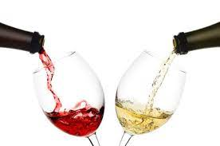
Introduction
In the realm of winemaking, ensuring high-quality products is paramount. Every step contributes to the final taste and character of the wine, it's now possible to augment these traditional methods with data-driven approaches for more accurate and efficient quality prediction.
The goal of this study is to demonstrate how ML algorithms can be utilized to predict wine quality reliably, providing winemakers with valuable insights for process optimization and quality control.
Several machine learning algorithms including Decision
Trees, Random Forest and Support Vector Machines (SVM)
are implemented to build predictive models
Overall, this introduction lays the foundation for understanding the subsequent sections, results of wine quality prediction using ML and Python.

Slide 4
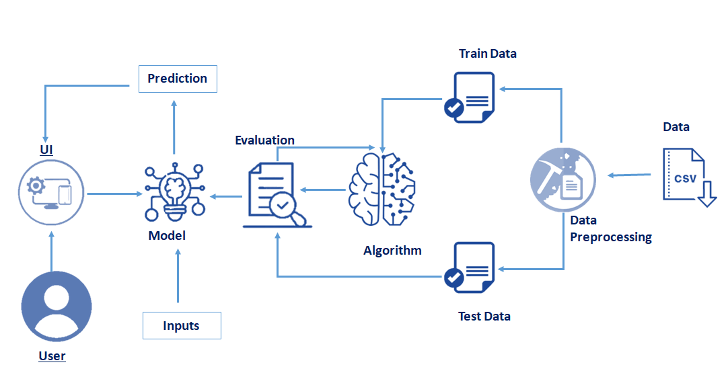
Existing System
Existing systems for wine quality prediction using machine learning (ML) and Python have garnered significant attention due to their potential to revolutionize the wine industry. These systems leverage ML algorithms to analyze various physicochemical properties of wines and predict their quality ratings. Here are some key components and approaches commonly found in existing systems:
Data Collection and Preprocessing
Exploratory Data Analysis (EDA)
Feature Engineering
Model Selection and Training
Evaluation Metrics
Deployment and Integration
Continuous Improvement and Monitoring

Slide 5
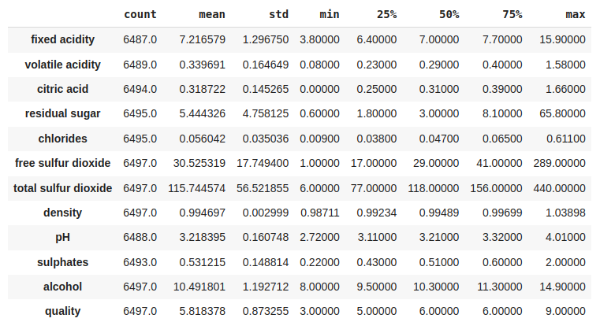
Proposed System
The proposed system, Wine Predict, aims to provide winemakers with a powerful tool for accurately predicting wine quality based on physicochemical properties. By leveraging machine learning techniques in Python, Wine Predict offers a data-driven solution to optimize production processes, improve quality control measures, and ultimately enhance the overall quality of wines.
Evaluate various ML algorithms including Decision Trees, Random Forest, Support Vector Machines (SVM), Gradient Boosting, and Neural Networks.

Slide 6
Architecture Diagram or System Diagram

Slide 7
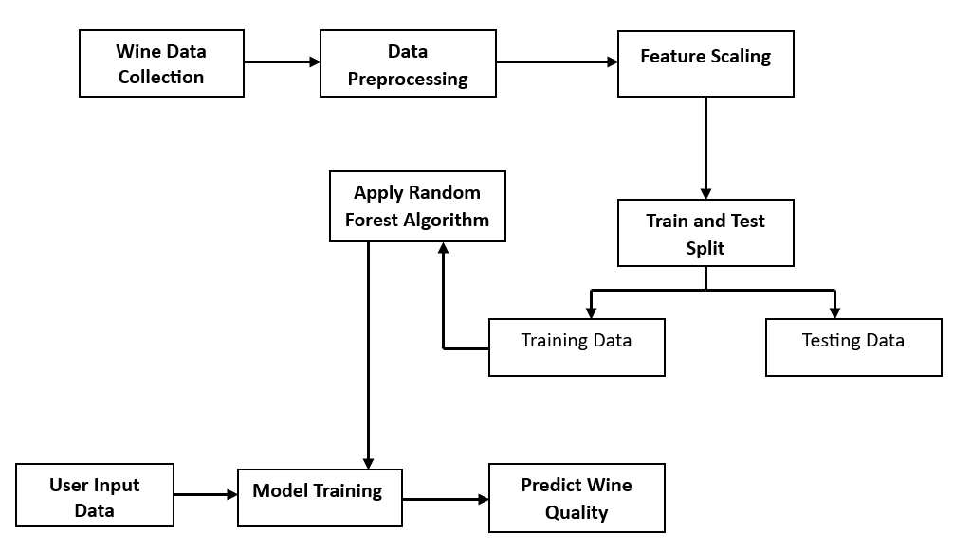
Architecture Diagram or System Diagram

Slide 8
Software Requirements Specification (SRS)

Slide 9
Software Requirement Specifications (SRS)
Python Libraries:
Pandas: Used for data manipulation and analysis.
NumPy: Used for numerical operations and computations.
Scikit-learn: Provides tools for machine learning tasks such as model training, evaluation, and preprocessing.
Matplotlib and Seaborn: Libraries for data visualization.
Jupyter Notebook or IDEs for development.
Visual Studio Code: For editing Python scripts and other files.
Operating System :While Python is cross-platform, ensure compatibility with your chosen operating system (Windows, macOS, Linux).
Kaggle for required Data set

Slide 10
Front End
Graphical User Interface (GUI) Toolkit: Choose a Python GUI toolkit such as Tkinter , Py Qt, or w x Python for building the frontend interface.
Input Fields: Develop input fields for users to input wine attributes.
Output Display: Display predicted wine quality to users within the GUI.

Slide 11
Back End
Python Web Framework: Choose a Python web framework such as Flask or Django to handle HTTP requests and responses.
Machine Learning Model Integration: Integrate the trained machine learning model into the backend server to make predictions.
Data Preprocessing: Implement data preprocessing logic if necessary before passing the input to the machine learning model.
Documentation: Provide documentation for users on how to interact with the application and interpret the results.

Slide 12
Hardware
Requirements
Specification(HRS)

Slide 13
Hardware Requirement Specifications (HRS)
CPU: A modern multi-core processor (e.g., Intel Core i5 or higher, AMD Ryzen 5 or higher) is sufficient for most tasks related to data preprocessing, model training, and evaluation.
RAM: At least 8 GB of RAM is recommended to handle large datasets efficiently, especially when using memory-intensive algorithms or conducting parallel processing.
Storage: Sufficient storage space (e.g., SSD or HDD) is needed to store datasets, software libraries, and model files. The amount of storage required depends on the size of datasets and any additional resources used in the project.
GPU(optional):For computationally intensive tasks mainly used NVIDIA GPUs (e.g., GeForce GTX or RTX series)

Slide 14
Application Modules
DATA ANALYSIS MODEL MODULE:
Data Collection Module:
Collects data from various sources such as databases, spreadsheets, or online repositories.
2. Data Preprocessing Module:
Cleans the collected data by handling missing values, outliers, and inconsistencies.
3. Feature Selection Module:
Identifies and selects the most relevant features for predicting wine quality.
MACHINE LEARNING MODULE:
Model Training Module:
Trains machine learning models using the preprocessed and feature-selected data.
2. Model Evaluation Module:
Evaluates the trained models using appropriate metrics such as mean squared error, accuracy.
3. Model Deployment Module:
Deploys the trained model into production environment for real-time prediction.

Slide 15
Implementation
These are simplified examples to give you an idea of how each modulemight be implemented. Depending on specific requirements and the libraries we choose, may need to adjust these code snippets.
Link:
https://github.com/Gajjelasanjay/Gajjelasanjay/blob/main/AD-2%20WINE%20QUALITY%20PREDICTION%20(1).py

Slide 16
System Models
(UML Diagrams)

Slide 17
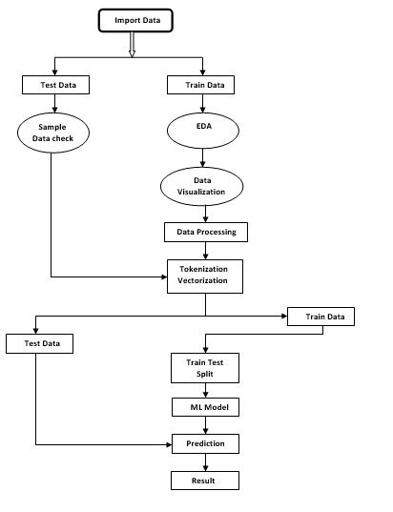
Work flow Diagram

Slide 18
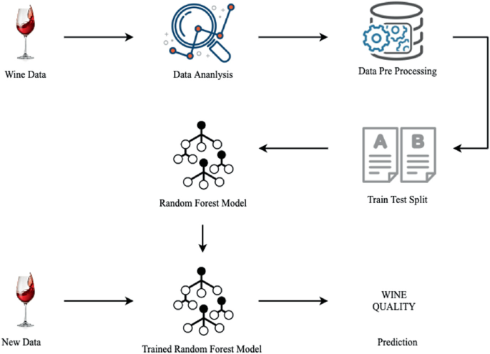
Flow Chart

Slide 19
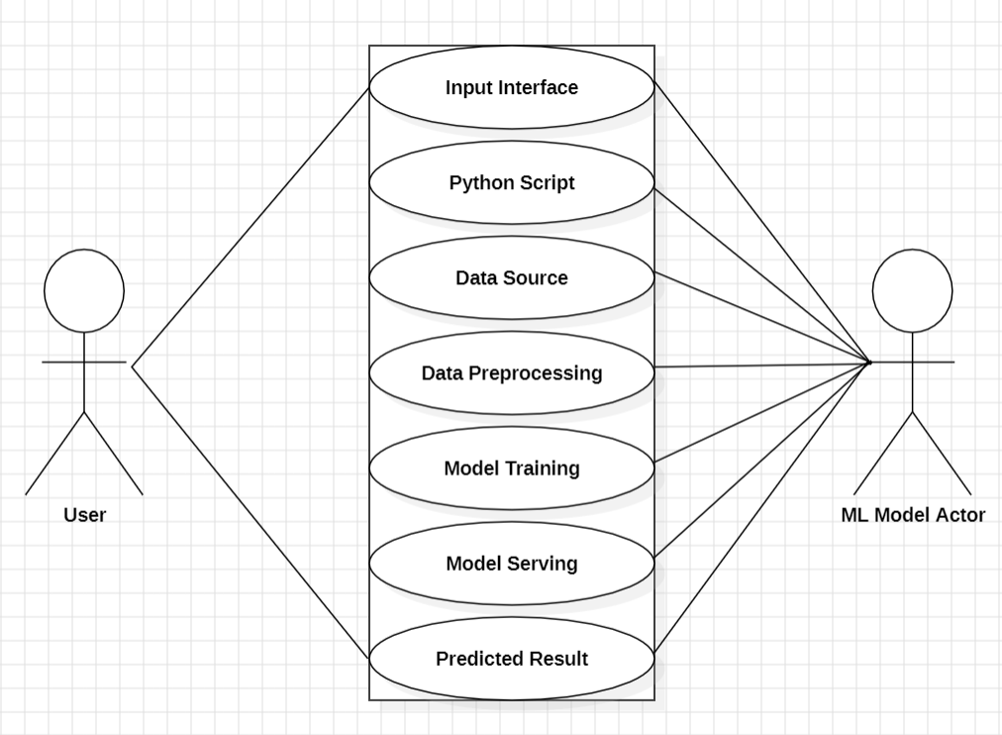
Use Case Diagram

Slide 20
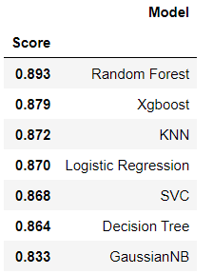
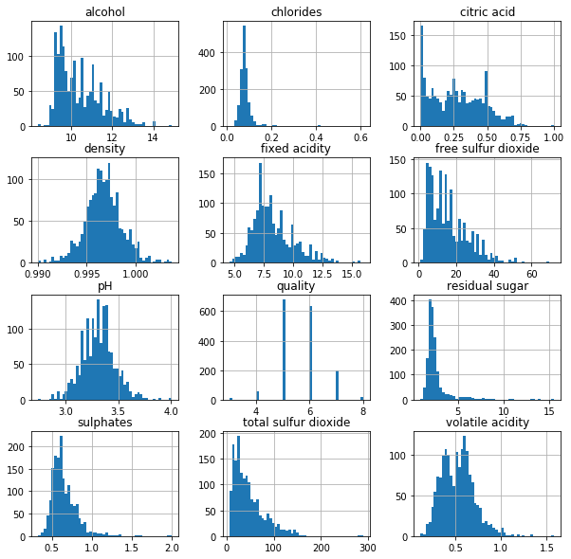
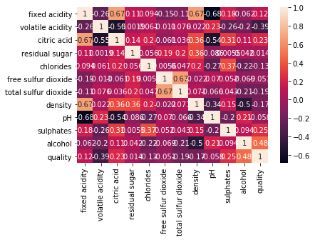
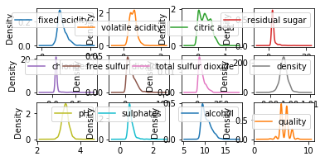
Output Screen

Slide 22
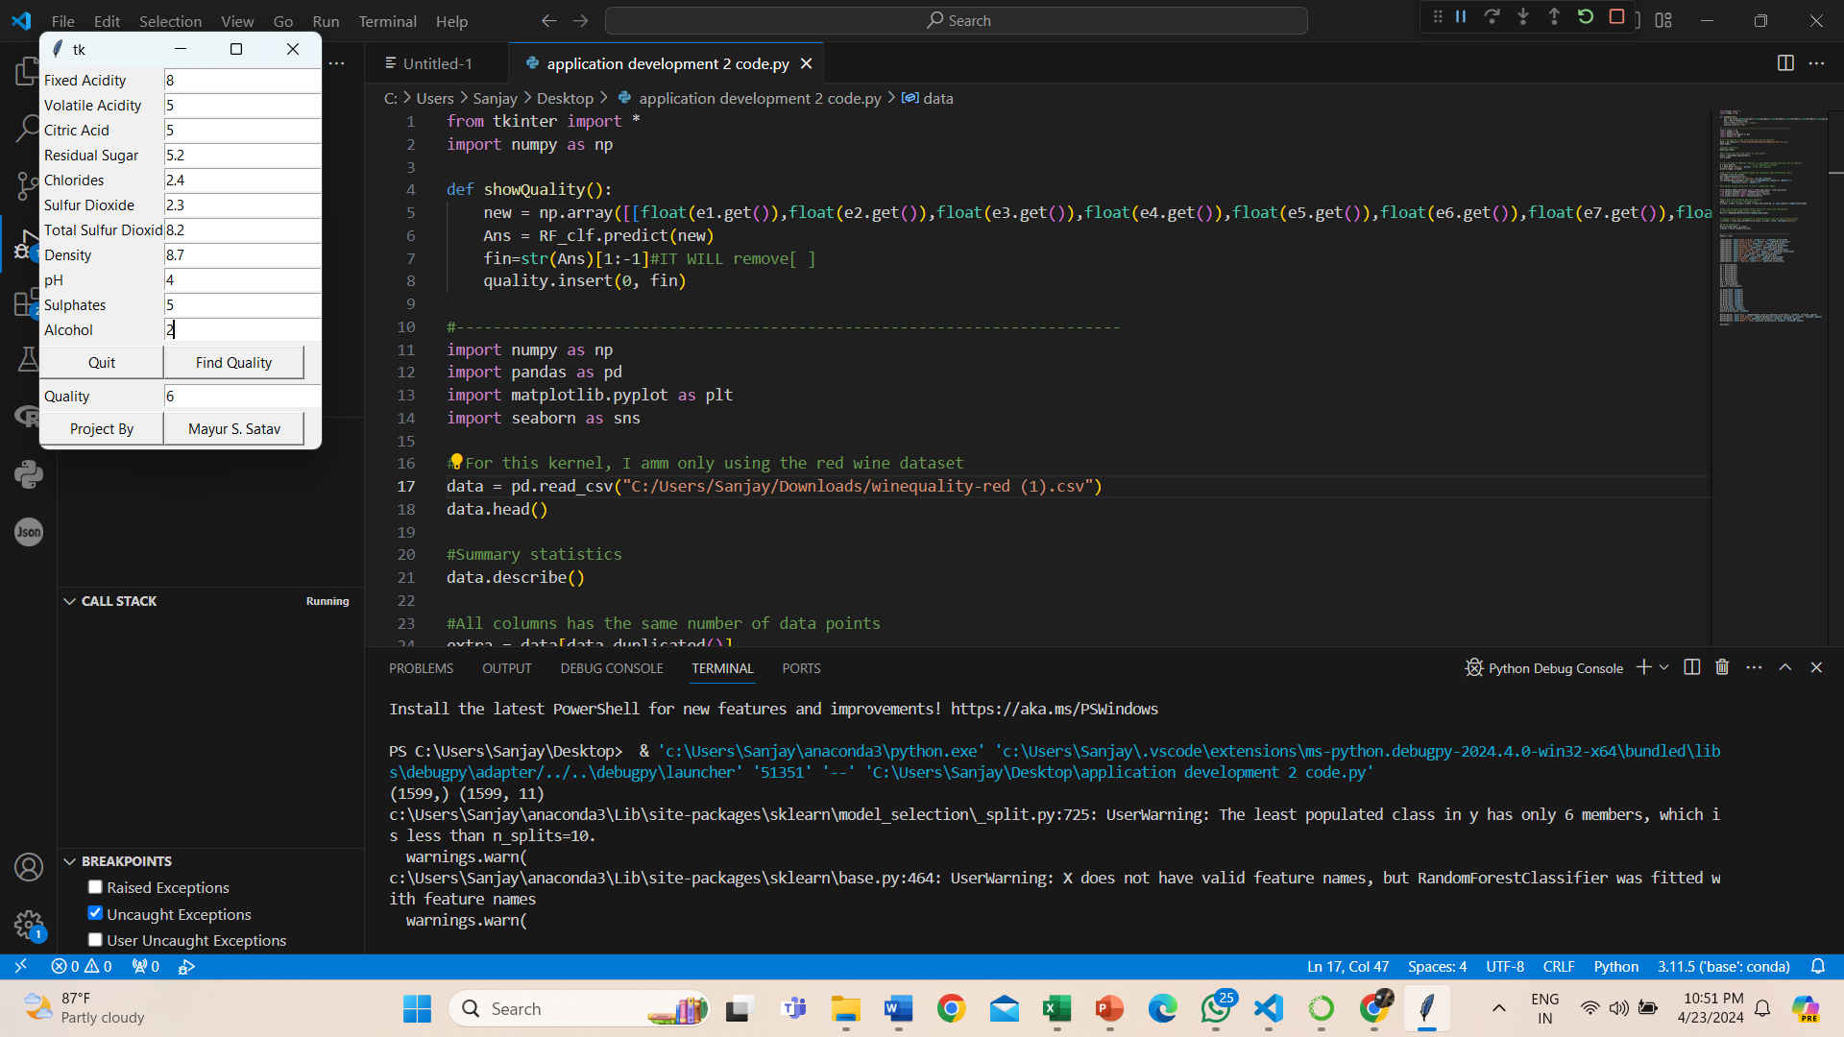
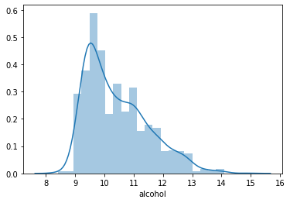
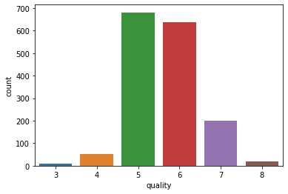

Slide 23
Conclusion and Future scope
CONCLUSION :In conclusion, the development of a wine quality prediction system using machine learning and Python offers promising opportunities for enhancing wine production and consumption. By leveraging advanced data analysis techniques and predictive modeling, such a system can provide valuable insights into the factors influencing wine quality and help winemakers optimize their processes.

Slide 24
Future Scope
Looking ahead, there are several venues for future exploration and improvement in this field:
Enhanced Prediction Models: Continued research into advanced machine learning algorithms and techniques can lead to more accurate and reliable prediction models.
Integration of Additional Data Sources: Incorporating additional data sources such as weather patterns, soil composition, and grape variety characteristics can enrich the predictive capabilities of the system.
Real-time Monitoring and Decision Support: Developing real-time monitoring capabilities can enable winemakers to make timely decisions and adjustments to optimize wine quality throughout the production process.
Personalized Recommendations: Tailoring recommendations based on individual preferences and tastes can enhance the user experience and satisfaction.

Slide 25
